Slide 1
Managing Personal Health Using Fishbone Diagram
-Structure of a Ishakawa Model
-Benefits of Good Health
-Causes of Unhealthy Weight
-Recommendation

Slide 2
Use of a Fishbone Diagram
Strategic management tools have generic usage
That means an effective concept including a Fishbone Diagram (Ishakawa Model) can be applied in noncommercial sector (Bowen, 2016).
Personally, I have struggled to retain good health by shedding off excess calories
However, I have grappled to achieve sustained outcomes
Intermitted weight-gain has been a major problem that I have struggled since my puberty age
Notes:
A Fishbone Diagram helps to solve complex challenge in the first round as opposed to patch remedies that address the symptoms of a problem. A Fishbone Diagram facilitates in the assessment of a cause and effect analysis because it entails brainstorming and mind-map capabilities. Therefore, in a concerted efforts with three accredited dietary practitioners to assess the causes and effects of relapse obesity condition, which has impacted negatively toward personal health. I have struggled with intermitted obesity since the puberty age, which necessitate implementation of a strategic management concept to evaluate on the causes and effects of such health problem.

Slide 3
Key Problem
Obesity is a disorder involving accumulation of excess body fat and calories
Obesity has detrimental physical and emotional challenges
First, excess body weight impedes physical fitness of an individual
Second, patient often experience fatigue and body pain
Third, obesity has other serious ailments including stroke and health attack
Four, modern society exert pressure on overweight individuals because of perceived preference to slender figures
Notes:
From a health education point of view, obesity is a non-communicable disease that endeavor to contribute to high mortality and morbidity rate in the society. Obesity is accumulation of excess fat around the body organs or under the skin. Obesity is a detrimental health condition that has become a profound health issue because of personal and community effects in the short-term and in the long-term time perspectives. Among the adverse health and social problems that relate to obesity include lack of physical aptness and body fatigue, which prevent an individual from engaging in their ordinary activities. Therefore, individuals and patients diagnosed with obesity are prescribed to take personal initiatives to combat the susceptibility to obesity

Slide 4
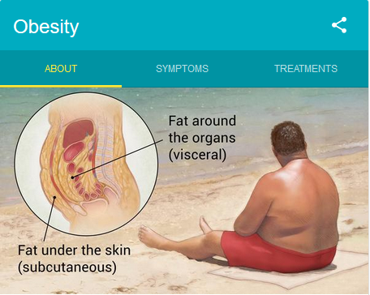
Applying Ishakawa Model to Investigate the Cause and Effects of Obesity
Step 1: Identifying the Problem
Obesity is a combination of multiple factors that include ;-
Genetic
Poor diet
Medical reason
Personal lifestyle
Socioeconomic parameters
Ineffective strategy to mitigate intermitted weight-gain and loss is a pertinent problem that I have had to struggle with
Notes:
A Fishbone Diagram Tool first step involves identification of problem considered pertinent and depicts adverse effects. A concerted effort to deliberate on the prominent problem is vital because it facilitate the team to identify a major problem. Consequently, a group deliberation involving three registered dietary practitioners identified obesity as a critical health problem that has adverse effect on individuals and society

Slide 5
Step 2: Analyzing the Causes of Obesity
Calories –
Refers to the energy quantity of the food consumed
Gender differences determine the amount of calories that a man and woman require per day
Different caliber of food contain varied amount of calories
Lack of physical exercise contributes toward excess calories
Notes:
Besides, a Fishbone Model requires detailed assessment about the identified problem to deliberate on the secondary factors. Accumulation of excess calories contribute toward obesity. NSH defines calories as the measure of the energy quantity of the food an individual consumes (2016). Gender parameter contributes the difference in the requirement of the calories with male considered to have the largest amount of energy. Further, different types of foods entail varied amount of calories, which require caution during the consumption. Equally, physical exercise helps to regulate the accumulation of excess calories and safeguard against obesity

Slide 6
Step 2: Analyzing the Causes of Obesity
B. Poor Diet
Poor diet is a critical contributor of obesity
Poor eating habit including
excessive alcohol consumption,
unbalanced food diet, and
consumption of soft drinks
Poor eating habits have detrimental effects because they cause obesity
Unhealthy eating can be acquired or learned behavior
Notes:
Poor diet is another profound cause of obesity. Consumption of excess alcohol, unbalanced diet, and eating large portion are the primary causes of obesity. Therefore, a change in lifestyle and embrace proper eating habit is a critical intervention to mitigate the prevalence of obesity. For example, consumption of a large portion of food that contain fat and sugar content has been a common habit among the young individuals. The availability of convenience eating-outlets and lack of amble time prepare balanced diets triggers individuals to consume junk food, which result in accumulation of fat.

Slide 7
Step 2: Analyzing the Causes of Obesity
C. Poor Lifestyles and Physical Activities
White-collar jobs are time consuming and involve sitting for long-hours
Further, failure to acknowledge the role of physical exercise is a bad habit
Several studies recommend individuals to engage moderate aerobic activity for two-and-half hours per day
Obese patients have to undertake more physical activities to convert excess fat in their body
Notes:
White-collar jobs are time consuming and prevent individuals from engaging in physical activities. Usually, such workers own motor vehicles that are used to ferry them to their workstations or from their homestead as opposed to taking a walk, which can prevent against accumulation of excess fat. The preferred relaxation activities also include watching television compared to engaging in physically-straining actions. Such practices have negative health outcomes for an individual because of the susceptibility to obesity

Slide 8
Step 2: Analyzing the Causes of Obesity
D. Medical Reasons
There are several medical conditions that result in accumulation of excess fat
Medical conditions that causes obesity include Hypothyroidism and Cushing’s Syndrome
Hypothyroidism is characterized by underactive thyroid gland, which limits ejection of adequate hormones (Stanford Healthcare.org, 2018)
Cushing’s Syndrome results in overproduction of steroid hormone (Ibid)
Individuals who stop smoking can exhibit weight-gain as a rare side effect (NHS, 2016)
Notes:
Patients prescribed to certain medicines have reported weight gain as a side-effect. Such medication should be replaced immediately to safeguard a patient against unplanned outcome. Other medical conditions that significant effects toward increasing susceptibility to obesity include manifestation of a Cushing’s Syndrome and Hypothyroidism. The Cushing’ Syndrome involves overproduction of steroid hormones that result imbalance and subsequent adverse health effect. Similarly, Hypothyroidism on the other hand affects thyroid glands by minimizing the production of hormone. The imbalance in production of hormone affects the ability of a body to function effectively, which result in changes in body weight

Slide 9
Step 2: Analyzing the Causes of Obesity
E. Genetic Disorder
Prader-Willi Syndrome is a genetic disorder that causes obesity
Genetic traits are inherited from one generation to the next
Inherited genes hamper efforts to mitigate obesity
However, such cases are rare because majority of obesity emanate from environmental factors
Notes:
Genetic disorder is a rare cause of obesity because of the traits transferred from one generation to the another. The Prader-willi Syndrome is a rare genetic mutation that causes obesity (NHS,2016). Further, increased appetites can be acquired from parents resulting in obesity. Inherited genes are considered as a challenge toward mitigating obesity because of inability to control. However, generic factor has the least prevalence compare to the other elements

Slide 10
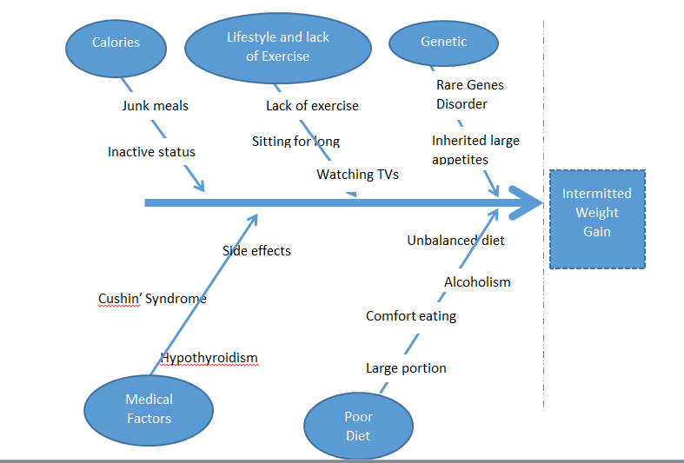
Fishbone Diagram
the problem under investigation is the occurrence of intermitted weight-gain
Five core-causes of the problem have been identified as the Genetic Attributes, Lifestyle Behavior, Calories Accumulation, Medical Condition, and Poor Diet
Therefore, an effective strategy should embrace the five parameters
Notes:
A Fishbone Diagram is a skeleton of a fish that provides an outline of possible causes to a protracted problem (Bowen, 2016). In an effort to address the recurring challenge of obesity, an Ishakawa Model was a preferable model to use to ascertain the potential causes and sub-factors that result in obesity. Consequently, five prominent causes were identified to key sources of obesity that include a rare genetic disorder termed as Prader-willi and inherited large appetite from my parent during the early ages. The genetic factor is difficult to regulate because of the intrinsic nature, which requires strategic approach to mitigate the prevalence of obesity. Other elements causing obesity include poor dietary habits, medical conditions, over-accumulation of calories and lack of physical exercises. For example, junk foods, sitting long hours on television, alcoholism are preventable habits that increases relapse of obesity. Importantly, these habits are easy to manage and mitigate by embrace effective lifestyles.

Slide 11
Recommendation
Initially, I considered poor eating habit as the sole cause of intermitted obesity
However, other factors including rare genetic element may have played core role
Therefore, my primary interventions are going to be;-
Regular exercise,
Proper eating habit,
Regular Medical Check-up and Dialyses,
Avoiding Alcoholic and Soft-drink Beverages
Notes:
The goal of a Fishbone Diagram as a strategic tool to enhance problem-solving in an organization and for personal benefits. The prevalence of preventable non-communicable diseases (NCD) that include obesity elicits significant challenge among the medical practitioners and stakeholders to design interventions to combat the morbidity as well as mortality rate. An important strategic intervention to prevent intermitted obesity is to encourage patients and individuals to embrace effective lifestyles that plays emphases on proper eating habit, regular exercising, and medical check-up. Importantly, utilizing proven strategic management tools to bolster decision-making processes is a key intervention to encourage and sustain personal initiatives to combat the spread of behavior non-communicable diseases. Therefore, I personally committed to sacrifice two-half hours per day to exercise and consume a balance-diet meal thrice

Slide 12
References
Bowen, P. (2016). The Fishbone Diagram Handbook - Everything You Need to Know about Fishbone Diagram, Emereo Limited
NHS (2016). “Obesity: Causes,” Author. Retrieved from www.nhs.uk/conditions/obesity/causes/#medical-reasons
Stanford Healthcare.org. (2018). “What are the causes and effects of obesity,” Reference. Retrieved from, www.reference.com/health/causes-effects-obesity-43c37ec512b1300d?aq=what+are+the+cause+of+obesity&qo=cdpArticles

